Slide 1
SQL Joins
As the name shows, JOIN means to combine something.
In case of SQL, JOIN means "to combine two or more tables".

Slide 2
Why SQL JOIN is used?
If you want to access more than one table through a select statement.
If you want to combine two or more table then SQL JOIN statement is used .it combines rows of that tables in one table and one can retrieve the information by a SELECT statement.
The joining of two or more tables is based on common field between them.
SQL INNER JOIN also known as simple join is the most common type of join.

Slide 3
Types of SQL JOIN
Inner Join
Left Outer Join
Right Outer Join
Full Outer Join
Cross Join

Slide 4
INNER JOIN
Staff table
ID | Staff_NAME | Staff_AGE | STAFF_ADDRESS | Monthley_Package
1 | ARYAN | 22 | MUMBAI | 18000
2 | SUSHIL | 32 | DELHI | 20000
3 | MONTY | 25 | MOHALI | 22000
4 | AMIT | 20 | ALLAHABAD | 12000

Slide 5

Payment table
Payment_ID | DATE | Staff_ID | AMOUNT
101 | 30/12/2009 | 1 | 3000.00
102 | 22/02/2010 | 3 | 2500.00
103 | 23/02/2010 | 4 | 3500.00
SELECT Staff_ID, Staff_NAME, Staff_AGE, AMOUNT
FROM STAFF s, PAYMENT p
WHERE s.ID =p.STAFF_ID;

Slide 6
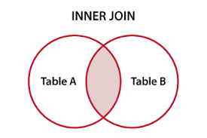
Output:
STAFF_ID | NAME | Staff_AGE | AMOUNT
3 | MONTY | 25 | 2500
1 | ARYAN | 22 | 3000
4 | AMIT | 25 | 3500
1 | ARYAN | 22 | 3000

Slide 7
SQL OUTER JOIN
Outer join of two types:
1.Left outer join (also known as left join): this join returns all the rows from left table combine with the matching rows of the right table. If you get no matching in the right table it returns NULL values.
2.Right outer join (also known as right join): this join returns all the rows from right table are combined with the matching rows of left table .If you get no column matching in the left table .it returns null value.

Slide 8

CUSTOMER TABLE
ORDER TABLE
ID | NAME | AGE | SALARY
1 | ARYAN | 51 | 56000
2 | AROHI | 21 | 25000
3 | VINEET | 24 | 31000
4 | AJEET | 23 | 32000
5 | RAVI | 23 | 42000
O_ID | DATE | CUSTOMER_ID | AMOUNT
001 | 20-01-2012 | 2 | 3000
002 | 12-02-2012 | 2 | 2000
003 | 22-03-2012 | 3 | 4000
004 | 11-04-2012 | 4 | 5000

Slide 9

SQL SELECT ID, NAME, AMOUNT,DATE
FROM CUSTOMER
LEFT JOIN ORDER
ON CUSTOMER.ID = ORDER.CUSTOMER_ID;
SQL SELECT ID,NAME,AMOUNT,DATE
FROM CUSTOMER
RIGHT JOIN ORDER
ON CUSTOMER.ID = ORDER.CUSTOMER_ID;

Slide 10
Inner join
Outer join
ID | NAME | AMOUNT | DATE
1 | ARYAN | NULL | NULL
2 | AROHI | 3000 | 20-01-2012
2 | AROHI | 2000 | 12-02-2012
3 | VINEET | 4000 | 22-03-2012
4 | AJEET | 5000 | 11-04-2012
5 | RAVI | NULL | NULL
ID | NAME | AMOUNT | DATE
2 | AROHI | 3000 | 20-01-2012
2 | AROHI | 2000 | 12-02-2012
3 | VINEET | 4000 | 22-03-2012
4 | AJEET | 5000 | 11-04-2012

Slide 11
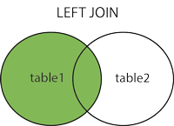
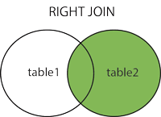

Slide 12
SQL FULL JOIN
The SQL full join is the result of combination of both left and right outer join and the join tables have all the records from both tables.
It puts NULL on the place of matches not found.
SELECT *
FROM table1
FULL OUTER JOIN table2
ON table1.column_name = table2.column_name;

Slide 13
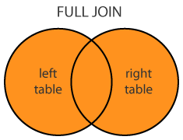
SQL FULL JOIN
table_A
table_B
Resulting table
A | M
1 | m
2 | n
4 | o
A | N
2 | p
3 | q
5 | r
A | M | A | N
2 | n | 2 | p
1 | m | - | -
4 | o | - | -
- | - | 3 | q
- | - | 5 | r

Slide 14
SQL Cross Join
When each row of first table is combined with each row from the second table, known as Cartesian join or cross join.
In general words we can say that SQL CROSS JOIN returns the Cartesian product of the sets of rows from the joined table.
SELECT * FROM MatchScore CROSS JOIN Departments

Slide 15
SQL Cross Join
MatchScore
Departments
Player | Department_id | Goals
Franklin | 1 | 2
Alan | 1 | 3
Priyanka | 2 | 2
Rajesh | 3 | 5
Department_id | Department_name
1 | IT
2 | HR
3 | Marketing

Slide 16
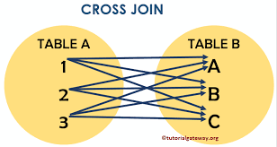
SQL Cross Join
result:
Player | Department_id | Goals | Depatment_id | Department_name
Franklin | 1 | 2 | 1 | IT
Alan | 1 | 3 | 1 | IT
Priyanka | 2 | 2 | 1 | IT
Rajesh | 3 | 5 | 1 | IT
Franklin | 1 | 2 | 2 | HR
Alan | 1 | 3 | 2 | HR
Priyanka | 2 | 2 | 2 | HR
Rajesh | 3 | 5 | 2 | HR
Franklin | 1 | 2 | 3 | Marketing
Alan | 1 | 3 | 3 | Marketing
Priyanka | 2 | 2 | 3 | Marketing
Rajesh | 3 | 5 | 3 | Marketing

Slide 17
THANK YOU

